Slide 1

Introduction to API Management

Slide 2
For more information, see Use of Microsoft Copyrighted Content at
http://www.microsoft.com/en-us/legal/intellectualproperty/Permissions/default.aspx
Active Directory, Azure, HDInsight, Microsoft, MSDN, Microsoft Dynamics, Windows Intune, Office 365, Outlook, PowerShell, SQL Server, Visual Studio, WebMatrix, Windows, Windows Phone, Windows Server, Windows Vista, Xbox 360 and Zune are either registered trademarks or trademarks of Microsoft Corporation in the United States and/or other countries. Other Microsoft products mentioned herein may be either registered trademarks or trademarks of Microsoft Corporation in the United States and/or other countries. All other trademarks are property of their respective owners.

Slide 3
Module 01: Introduction
Notes:
Overview
This module includes the following sections:
Overview of Cloud Computing
Cloud Computing Patterns
Compute Components of Azure
Other Azure services
Objectives
After this module, you will be able to:
Introduce benefits of the cloud
Usage patterns
Cloud Model (abstraction layers)

Slide 4



Microsoft Enterprise Integration
API Management
Create API frontends for backends in the cloud and on-premises Protect, monitor and monetize the APIs Onboard external and internal app developers
Event Grid
Connect supported Azure and third-party services fully managed event-routing service publish-subscribe model that simplifies event-based app development
Logic Apps
Connect SaaS applications Serverless flows, auto scaling, fully managed. Leverage Azure Services
Service Bus
Cloud-based messaging service Connect to the cloud Secure and predictable message delivery

Slide 5

Azure API Management
API consumers
AZURE API MANAGEMENT
Abstraction
decouple
modernize
optimize
...
Middleware
secure
protect
cache
...
Monitoring
usage
health
monetization
...
Developer
discover
document
on-board
...
Custom APIs on Azure
Azure APIs
On-prem APIs
3rd party APIs

Slide 6









Customer use cases
Enterprise API catalog
Customer and partner integration
Mobile enablement and IoT
APIs as a business
Gateway for microservices

Slide 7
 | Customers | Instances | Calls | APIs
Growth (trailing 12 months) | +100% | +65% | +230% | +244%
Total (as of Oct 31) | 12K | 24K | 4B per day | 170K
Notes:
SwissRe, Munich Re, Premera, Bupa UK, Bupa Australia, NHS, Geico

Slide 8



AZURE API
MANAGEMENT
APP DEVELOPERS
Developer Portal
DIRECT OR
VPN
BACKEND
APIs
APPS
API Gateway
Hosted anywhere.
Developed using any technology.
API PUBLISHERS
Publisher portal

Slide 9
API Gateway
Network endpoint that:
Accepts API Calls from clients
Verifies API keys and other credentials
Enforces quotas and rate limits
API Transformations
Caching
Logging
Notes:
https://docs.microsoft.com/en-us/azure/api-management/api-management-using-with-vnet

Slide 10
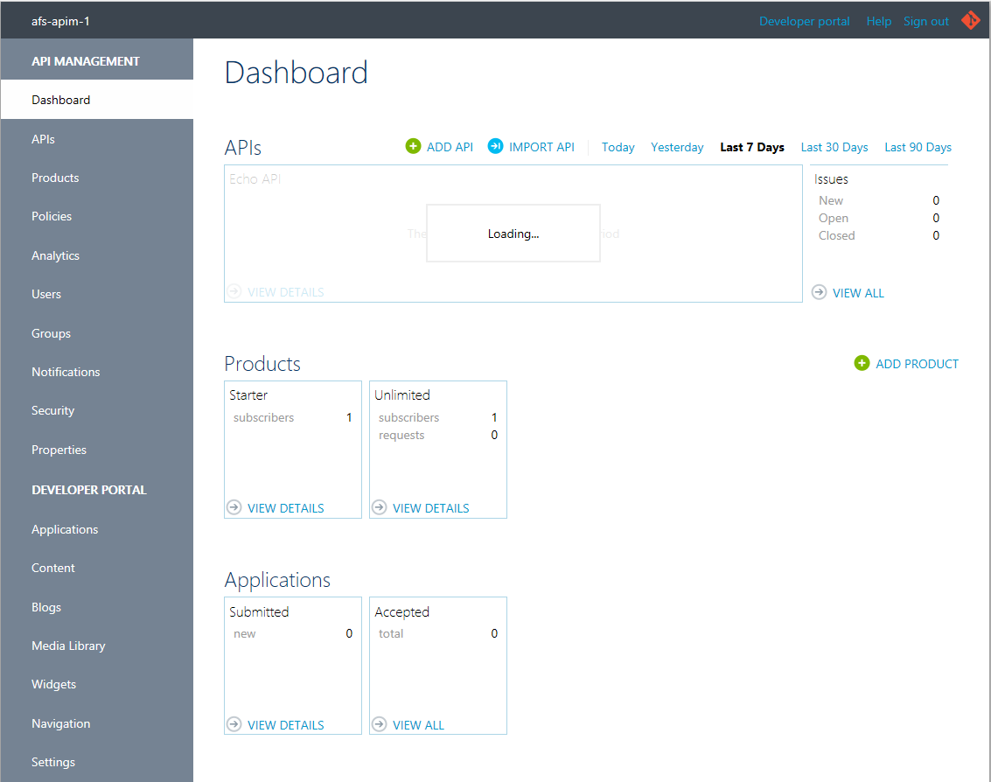
Publisher Portal
Web UI used for:
Define APIs and Operations
Define Products
Configure Policies
Analytics
Usage management

Slide 11
Developer Portal
Where consumers of APIs can:
Find available APIs
Read API Documentation
Test APIs
Create accounts and subscribe to products
Access usage analytics

Slide 12
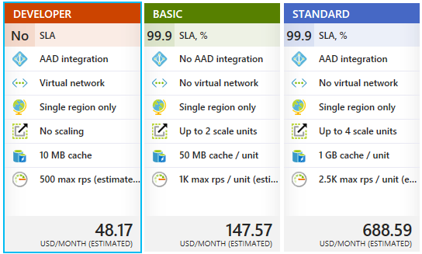
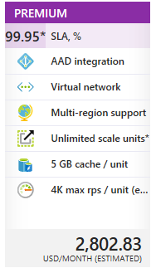
Pricing Tiers

Slide 13
Networking
Deploy APIM on an Azure Vnet
Allows APIM to access on-Vnet or on-premises resources
Site-to-Site VPN
Express Route
Vnet must be in same region as API Management resource *
Must use dedicated Subnet
* 1 per region for multi-region deployments
Notes:
https://docs.microsoft.com/en-us/azure/api-management/api-management-using-with-vnet

Slide 14
Networking – Internal VNet
All service endpoints accessible only in Vnet
Gateway
Developer Portal
Publisher Portal
Management
Git
No service endpoints registered in DNS
Notes:
https://docs.microsoft.com/en-us/azure/api-management/api-management-using-with-internal-vnet

Slide 15
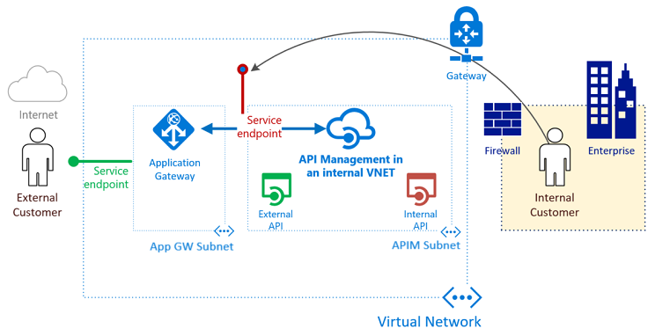
Networking – Internal VNet with AG
API Management deployed in internal network mode
Service endpoint exposed through App Gateway to external customers
Notes:
https://docs.microsoft.com/en-us/azure/api-management/api-management-howto-integrate-internal-vnet-appgateway

Slide 16
Module 02: Defining APIs
Notes:
Overview
This module includes the following sections:
Overview of Cloud Computing
Cloud Computing Patterns
Compute Components of Azure
Other Azure services
Objectives
After this module, you will be able to:
Introduce benefits of the cloud
Usage patterns
Cloud Model (abstraction layers)

Slide 17
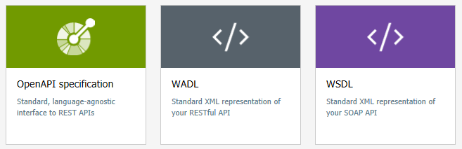
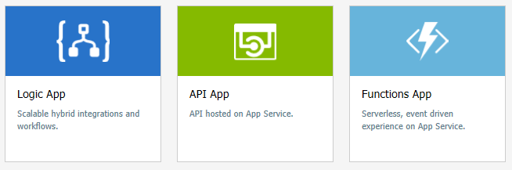
Defining APIs
Define from scratch in portal
Import API description
Reference Azure Service

Slide 18
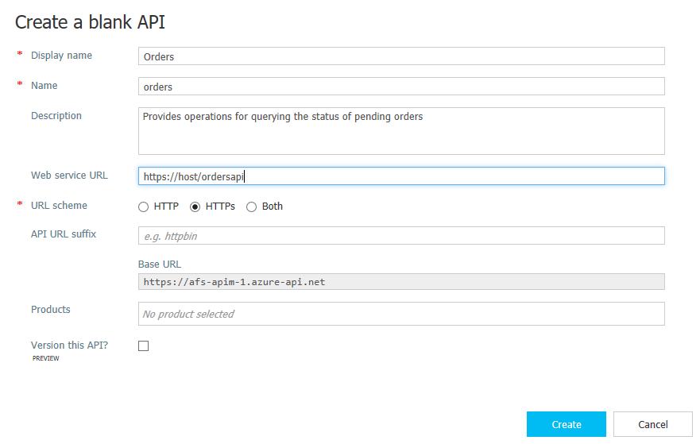
Creating an API from Scratch

Slide 19
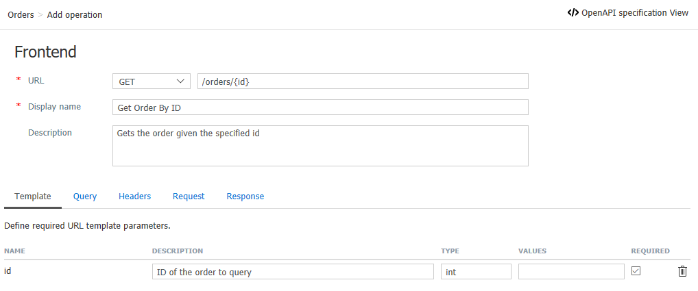
Creating an API from scratch

Slide 20
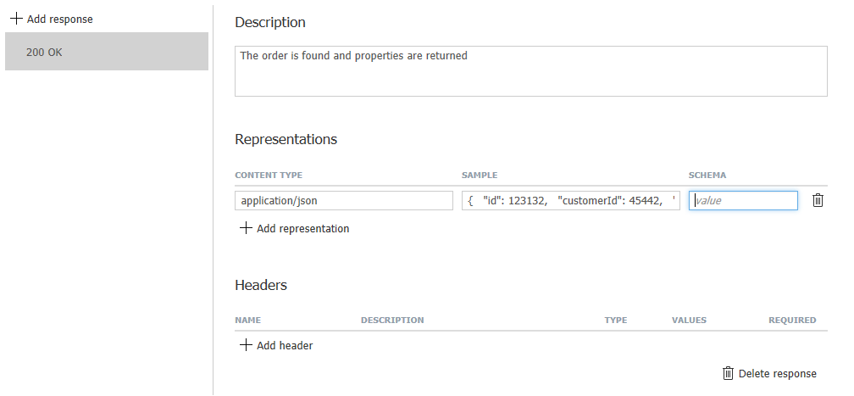
Creating an API from Scratch

Slide 21
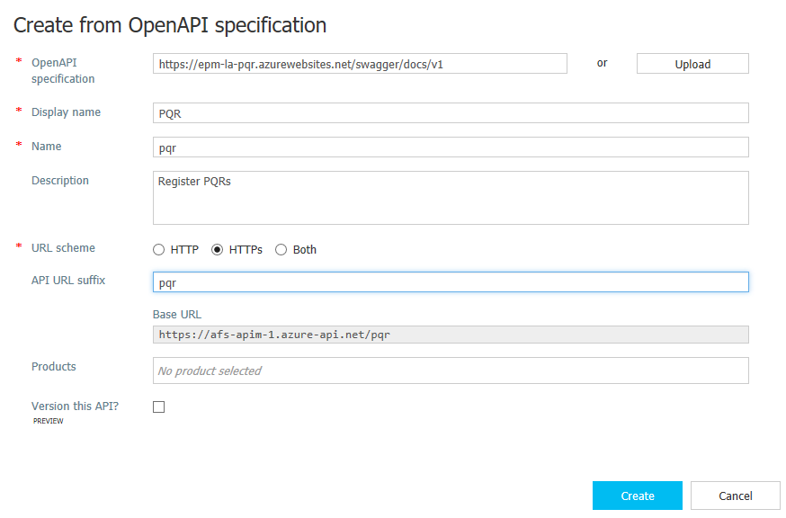
Importing Open API
Specify Swagger URL
Upload file
Operations and samples are derived from schema
Can be customized after

Slide 22
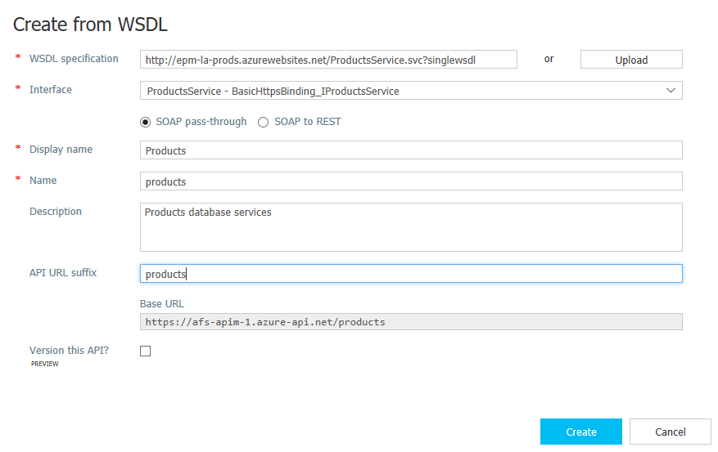
Importing a SOAP API

Slide 23
Importing a SOAP API
Tips:
Use ?singleWsdl with WCF services
Do not fill in a description on the wizard
Make sure to choose a secure endpoint
Only this is supported:
WS-I Basic Profile 1.1
SOAP 1.1 and 1.2
WSDL 1.1
Limited authentication options
No Kerberos / windows credentials
No WS-Security

Slide 24
Importing a SOAP API
SOAP pass thru
Gateway receives SOAP
SOAP to REST
Gateway receives REST
SOAP sent to service
SOAP sent to service
Notes:
https://blogs.msdn.microsoft.com/apimanagement/2016/10/13/soap-pass-through/
https://blogs.msdn.microsoft.com/apimanagement/2016/12/14/soap-to-rest/

Slide 25
Importing a SOAP API
SOAP passthru
Gateway receives SOAP
SOAP to REST
Gateway receives REST
SOAP sent to service
SOAP sent to service
Notes:
https://blogs.msdn.microsoft.com/apimanagement/2016/10/13/soap-pass-through/
https://blogs.msdn.microsoft.com/apimanagement/2016/12/14/soap-to-rest/

Slide 26
Module 03: Products & Subscriptions
Notes:
Overview
This module includes the following sections:
Overview of Cloud Computing
Cloud Computing Patterns
Compute Components of Azure
Other Azure services
Objectives
After this module, you will be able to:
Introduce benefits of the cloud
Usage patterns
Cloud Model (abstraction layers)

Slide 27
Products
How you offer APIs to consumers
Default products: Starter & Unlimited
A Product has:
A name, display name & description
Legal Terms
One or more APIs
Has access control
Determines which users can view / subscribe
Only “published” products are visible to non-admin users

Slide 28
Open Products
Have the “Require subscription” check disabled
An API can only belong to 1 Open Product at most
Can be called without a key
Open products are not listed in Developer Portal

Slide 29
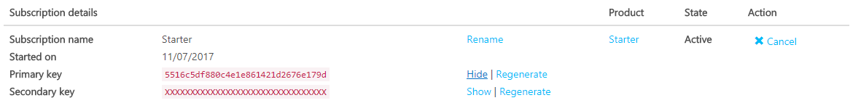
Subscription
Created when:
User signs up for a product – Might require approval from admin
Admin creates a subscription on behalf of user
Can be cancelled by user or administrator
Has primary/secondary keys used for authentication on API calls

Slide 30
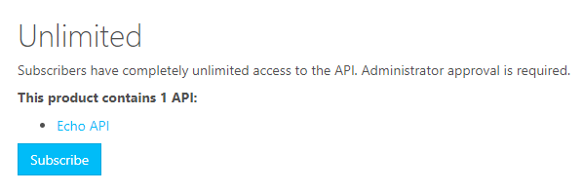
Subscriptions
Admins automatically get subscriptions to all products
Product can allow:
Only 1 subscription per user
Multiple subscriptions per user

Slide 31
Subscriptions
Subscription keys can be regenerated
Previous key is disabled
Used when key has been compromised

Slide 32
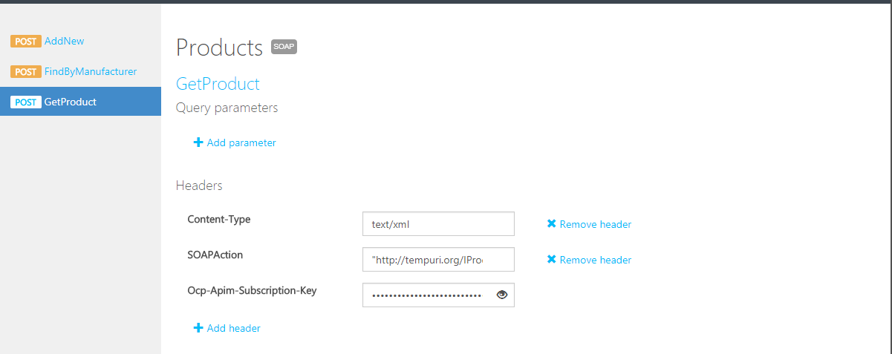
Testing APIs
Developer can test access to subscribed APIs in Dev Portal
Requires a Subscription Key

Slide 33
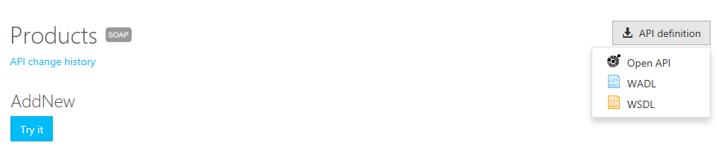
Invoking APIs - Metadata
You can get metadata for an API through Developer Portal:

Slide 34
Invoking APIs - Authentication
HTTP Header
Ocp-Apim-Subscription-Key
Query String
subscription-key
For Closed Products – authentication with Subscription Key required
Names of header/parameter can be changed per-api

Slide 35
Module 04: Policies
Notes:
Overview
This module includes the following sections:
Overview of Cloud Computing
Cloud Computing Patterns
Compute Components of Azure
Other Azure services
Objectives
After this module, you will be able to:
Introduce benefits of the cloud
Usage patterns
Cloud Model (abstraction layers)

Slide 36
What are policies?
Pre/Post processing and validation of incoming requests
Can be defined at multiple levels:
Operation
API
Product
Each policy is defined as an XML document
Dynamic expressions are wrapped in @()
Defined in Publisher Portal (or Azure Portal)
Notes:
https://docs.microsoft.com/en-us/azure/api-management/api-management-policy-reference

Slide 37
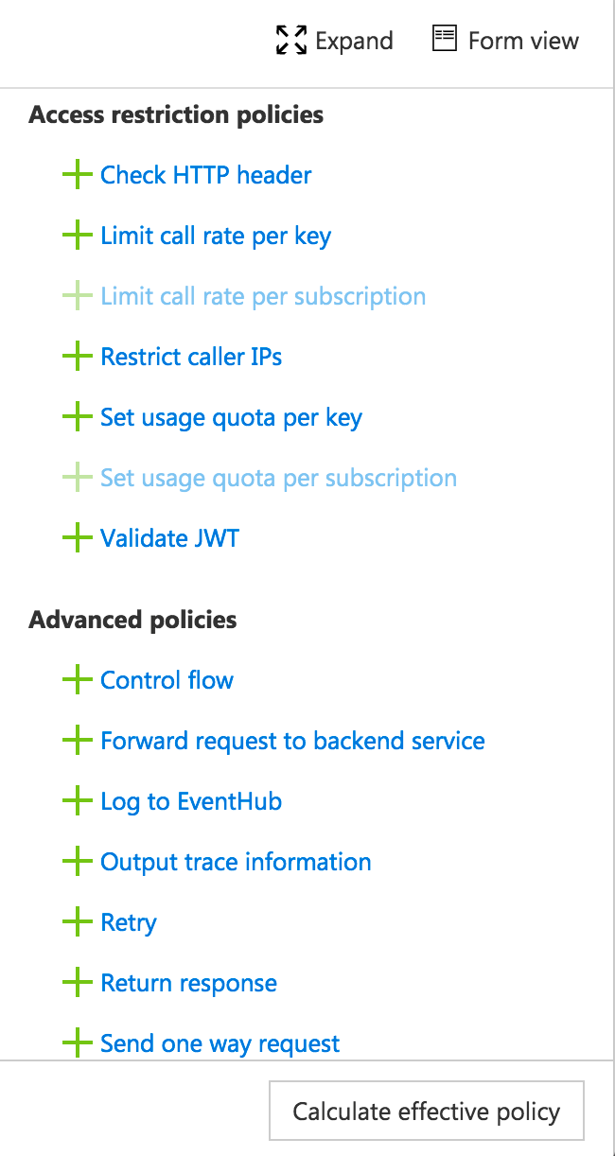
Policies
Encapsulate common API management functions
Access control, Protection, Transformation, Caching, …
Chained together into a pipeline
Mutate request context or change API behavior
Set in the inbound and outbound directions
Can be triggered on error
Applied at a variety of scopes

Slide 38
Policy scopes
GET /foo/bar HTTP/1.1
Host: api.constoso.com
Key: 0123456789
global
CORS
LOG
0123456789
product
from caller
RATE
QUOTA
inbound
to backend
/foo
api
JWT
/bar
operation
CACHE
URL
BODY
to caller
from backend
outbound

Slide 39
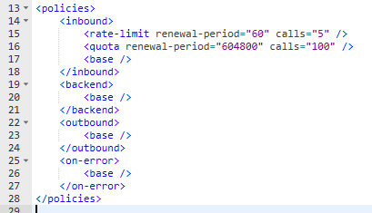
Policies - Example
Limit to 5 calls / minute
Maximum 100 calls / week

Slide 40
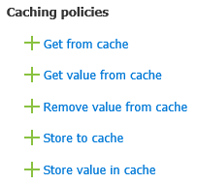
Caching Policies
Cache full responses:
Store to cache / Get from cache
Cache partial values
Store value in cache / Get value from cache

Slide 41
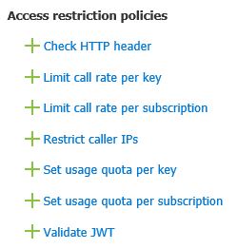
Access restriction Policies
Check HTTP header:
Validate request contains header with value
Call rates:
Per subscription or per key
Quota
Per subscription
Restrict caller Ips
Restricts where api can be called from
Validate JWT
Validate JWT tokens before calling API

Slide 42
Protection / Control
Rates: prevent API usage spikes and can be configured with policies by subscription or by key.
Call Rate By Subscription: subscription based by limiting call rate to a specific number in a period of time
Call Rate By Key: key based, which can be an arbitrary string typically specific using an expression, by limiting call rate to a specific number in a period of time.
Rates
Quotas: enforces a renewable or lifetime call volume and/or bandwidth quota subscription or key based.
Quota By Subscription: subscription based quota control for calls number or bandwidth for operations in a period.
Quota By Key: key based quota control for calls number and/or bandwidth during a period. The key can be an arbitrary string usually specified using a policy expression
Quotas
Advanced scenarios can be achieved combining Call Rate and Quota with the By Key version such as IP Address Throttling, User Identity and more advanced expressions.
Advanced Throttling
Notes:
No final do mês de fevereiro foi publicada a versão final de um document denominado RTS onde são enumerados os requisites técnicos de compliance com PSD2. Na realidade nem toda a especificação se baseia em regras o que significa que parte do document baseia-se em recomendações. Exemplo o mecanismo de autenticação necessita de suportar processos de autenticação a 2 fases usando 2 elementos diferentes como por exemplo uma password e um pin através do dispositivo móvel. Por outro lado as entidades bancárias estavam à espera de uma standardização das APIs a serem expostas, o que na realidade não aconteceu. Existem já algumas aproximações como a definição do Open Banking Project em UK. Também a entidade ERPB tem grupos de trabalho que podem ser usados pelos bancos para terem um aproximação à standardização das APIs. Não vou passar em detalhe os requisites que fica para vossa referência, mas o que se pode enfacizar é que existe um foco muito grande em segurança, com mecanismos como multi-factor authentication, TLS 1.2, é mais ou menos unânime que os standards de autenticação e autorização nas APIs serão oAuth 2.0 e Open Id Connect entre outros. Em relação a dados, eles são essencialmente organizados em 4 categorias, informação de contas, informação de pagamentos, dados de autenticação e dados publicos como bancos, atms, etc.
Do ponto de vista de documentação de APIs Swagger é o mais comum assim como o formato a adopter será APIs Restful em Json.

Slide 43
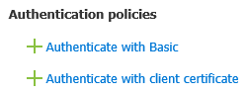
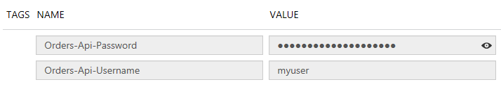
Authentication Policies
Secure connection between API gateway and API
Basic authentication
TLS Mutual Authentication
Use Named Values to avoid hardcoding sensitive values in policy
Notes:
https://docs.microsoft.com/en-us/azure/api-management/api-management-howto-properties

Slide 44
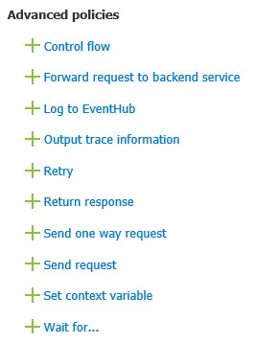
Advanced Policies
Control Flow == When/Case *
Forward Request == send request to backend
Retry == implement retry policy
Return an HTTP response
Others can be used to implement fan-out, logging / audit and other patterns
* Combined with Set-Backend-Url can be used for Dynamic routing
Notes:
https://docs.microsoft.com/en-us/azure/api-management/api-management-log-to-eventhub-sample

Slide 45
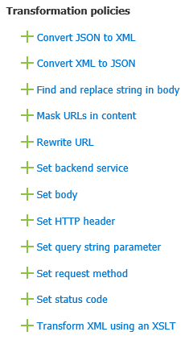
Transformation Policies
Content Conversion
XML <-> JSON
Modifying request or responses
Masking, replace strings
Rewriting URLs
Pretty URLs exposed and converted internally
Change backend URL
Change request / response
Apply XSLT

Slide 46
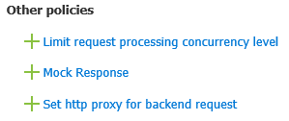
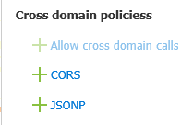
Other Policies
Concurrency
Mocking service responses (during dev)
Proxy URL
CORS policies

Slide 47
Effective Policy
Combination of Product / Api / Operation policies
Keep it simple
Some policies only make sense in certain scopes
Example: Subscription quotas only make sense at the Product level

Slide 48
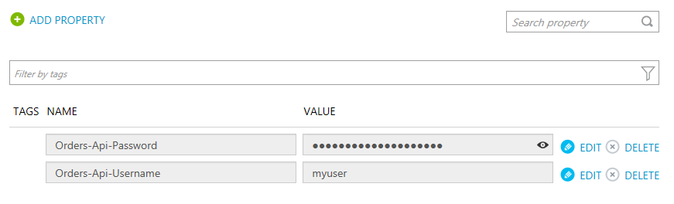
Properties
Key / Value Store
Provides reusable values across policies
Values can be secret (not displayed in UI)
Used with “{{propertyName}}” in policies

Slide 49
Policy Expressions
C# 6.0 expressions embedded in the XML policy
Has implicit context variable
Can use a subset of .NET Framework Types
@(expression)
@{expression}
Single statement Expression
Multi-statement Expression
Notes:
https://docs.microsoft.com/en-us/azure/api-management/api-management-policy-expressions

Slide 50
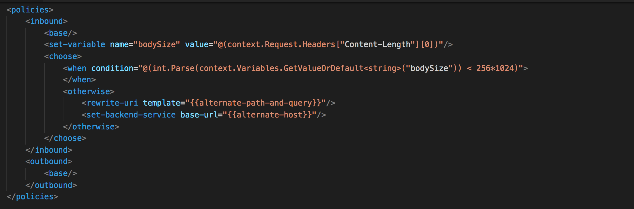
Policy expressions

Slide 51
Policy Expressions - Samples
@(true)
@((1+1).ToString())
@("Hi There".Length)
@(Regex.Match(context.Response.Headers.GetValueOrDefault("Cache-Control",""), @"max-age=(?<maxAge>\d+)").Groups["maxAge"]?.Value)
@(context.Variables.ContainsKey("maxAge") ? int.Parse((string)context.Variables["maxAge"]) : 3600)

Slide 52
Policy Expressions - Samples
@{
string value;
if (context.Request.Headers.TryGetValue("Authorization", out value))
{
return Encoding.UTF8.GetString(Convert.FromBase64String(value));
}
else
{
return null;
}
}

Slide 53
Module 05: Security
Notes:
Overview
This module includes the following sections:
Overview of Cloud Computing
Cloud Computing Patterns
Compute Components of Azure
Other Azure services
Objectives
After this module, you will be able to:
Introduce benefits of the cloud
Usage patterns
Cloud Model (abstraction layers)

Slide 54
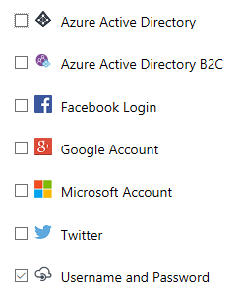
Developer Portal - Authentication
Username & Password by default
Multiple identity providers supported
Supports on-boarding process
New user sign-up
Can present legal terms on sign-up

Slide 55
Securing API Gateway – Backend Communication
Ensures API only callable through API Management
Or from a valid client
Options:
TLS Mutual Authentication*
Basic Authentication*
IP Restrictions
* Uses policies

Slide 56
Securing API Calls - Tokens
Added on top of Subscription Keys
OAuth 2.0
OpenID Connect
Tokens can be validated at API Management
Or forwarded to API for validation

Slide 57
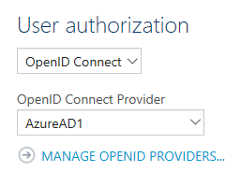
OAuth / OpenID configuration
API can be configured to require OpenID Connect / OAuth authentication
Only affects developer portal experience
Does not cause portal to validate tokens
OpenID Connect or OAuth2 services need to be pre-configured

Slide 58
JWT Token Validation
JWT tokens can be pre-validated in Policy
Token Signature
Token Claims
Tenant Metadata URI
<validate-jwt
failed-validation-error-message="Unauthorized. Access token is missing or invalid."
failed-validation-httpcode="401"
header-name="Authorization">
<openid-config url="https://login.microsoftonline.com/{tenantId}/.well-known/openid-configuration" />
<required-claims>
<claim name="aud">
<value>https://{tenant}.onmicrosoft.com/a6c6fa51-3639-4d4f-b7d6-1f3c03c78227</value>
</claim>
</required-claims>
</validate-jwt>
Expected claim value

Slide 59
Module 06: Management
Notes:
Overview
This module includes the following sections:
Overview of Cloud Computing
Cloud Computing Patterns
Compute Components of Azure
Other Azure services
Objectives
After this module, you will be able to:
Introduce benefits of the cloud
Usage patterns
Cloud Model (abstraction layers)

Slide 60
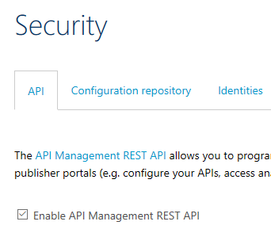
REST API
REST Management Service
Manage:
APIs
Products
Subscriptions
Policies
Certificates
Users
More
Not enabled by default
Notes:
REST API Documentation: https://docs.microsoft.com/en-us/rest/api/apimanagement/

Slide 61
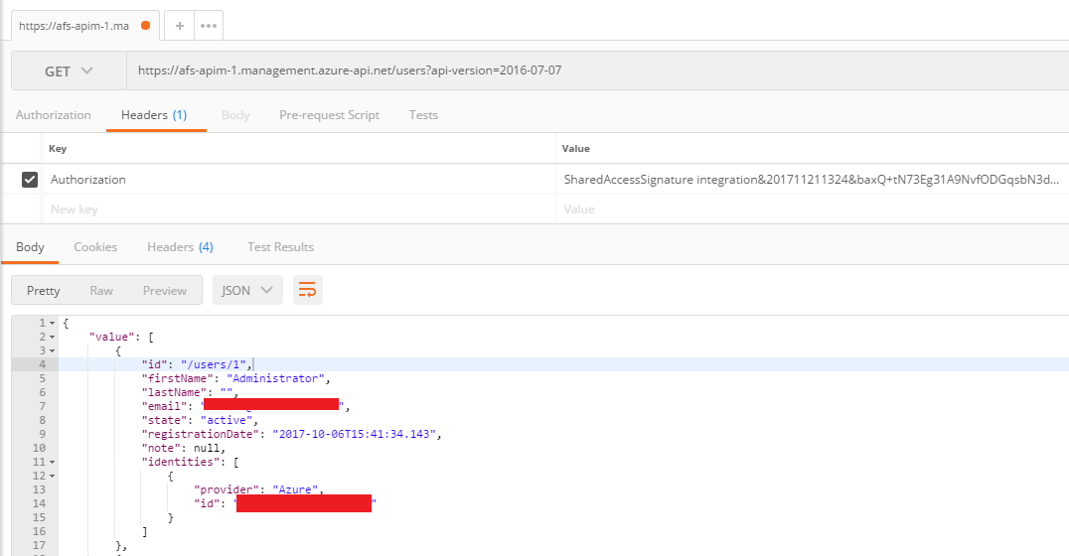
REST API

Slide 62
Configuration Repository
Based on Git
Text-File representation of:
APIs
Operations
Products
Policies
Groups
Portal Templates
Authorization Services
Supports:
Backing up configuration
Deploying configuration changes

Slide 63
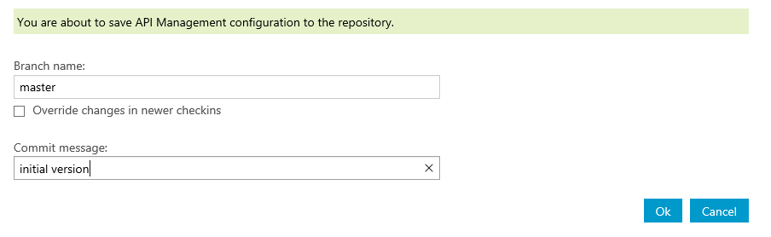
Configuration Repository - Cloning
Save Configuration to Repository
Copies internal DB into Git repository
Clone the repository
git clone https://<instance>.scm.azure-api.net/

Slide 64
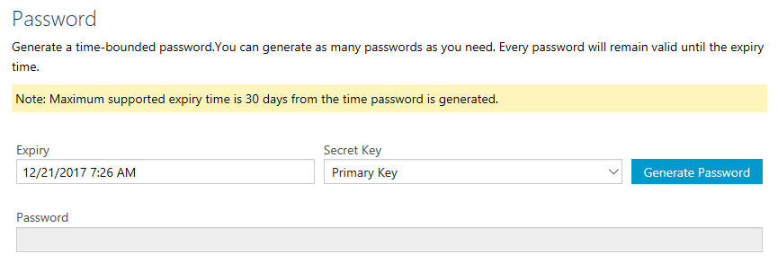
Configuration Repository - Cloning
Username: apim
Password: Generate in portal:

Slide 65
Configuration Repository - Deployment
Make changes to your local clone and commit
Push changes:
Deploy Repository Configuration
Make changes active in database
git add --all
git commit -m "description of your changes"
git push

Slide 66
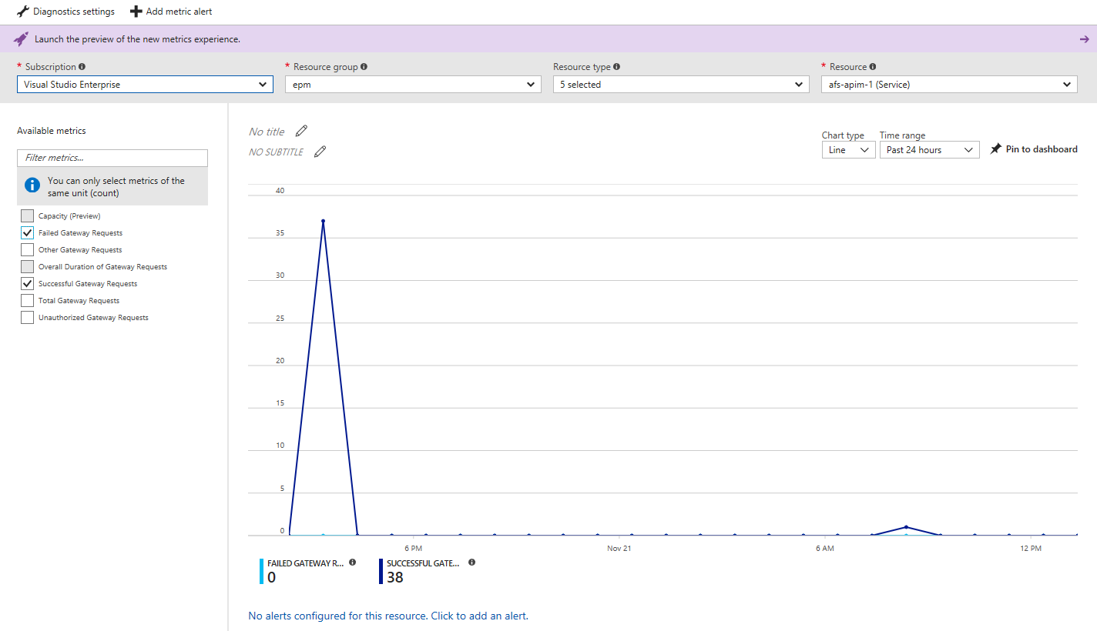
Metrics

Slide 67
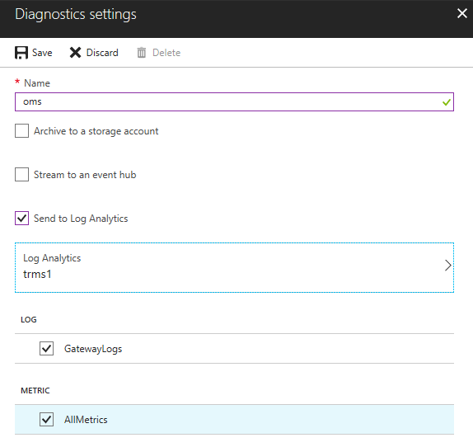
OMS - Integration
Enabled by turning on Diagnostic Logs
Can send:
Gateway Logs
Metrics
Only log search available
No OMS Solution at this time

Slide 68


